Slide 1
CV Café
The Art of the
CV Barista

Slide 2
What kind of mug are you?
Write down a few words to describe the owner of each coffee cup:

Slide 3
Mugshot #1

Slide 4
Mugshot #2

Slide 5
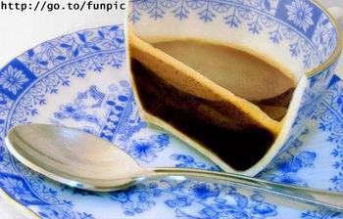
Mugshot #3

Slide 6
Mugshot #4

Slide 7
Mugshot #5

Slide 8
Mugshot #6

Slide 9
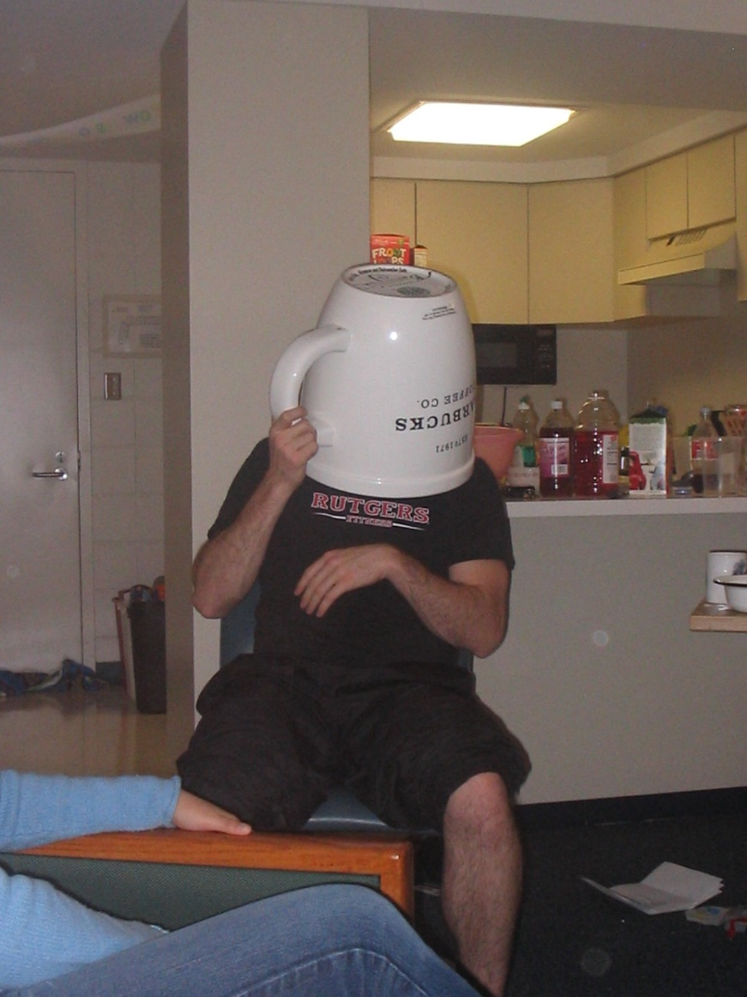
Mugshot #7

Slide 10
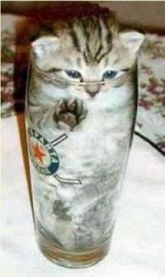
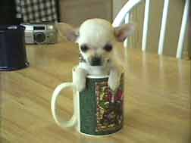
Mugshot #8

Slide 11
... no animals were harmed in the making of this presentation...

Slide 12
Ingredients conversion table
Coffee Ingredients
Espresso – the basis of any good cup of coffee
Steamed milk – adds substance and texture, and makes it taste less bitter
Frothed/foamed milk – added for decorative purposes, insubstantial
Chocolate syrup, sugar and other additives – add a little ‘spice’ or sweeten the drink
CV Ingredients
Concise, essential, relevant facts – the basis of any good CV
Details to support facts – written in appropriate language
‘Fluff’ - makes it look good on the surface – however most people don’t like too much of this
Something different, something colourful – need to know that the reader will like this

Slide 13
What are the ‘essential oils’
Summary of strengths
Education/qualifications
Experience
Contact details
Referees

Slide 14
Examples of additives
Personal statement
Career objective
Achievements
Community involvement
Interests
Publications
Memberships

Slide 15
Producing a shot of espresso
Try writing a Summary Profile
This is a summary of your strengths in three areas:
Experience
Education
Skills, personal qualities, talents...

Slide 16
Example 1: Hercules
Highly successful hero with background spanning numerous millennia
Twelve years experience as servant to King Eurystheus
Awarded Immortality status in recognition of work effort
Excellent Labour Completion skills, particularly with sets of twelve
Perfect embodiment of Greek Pathos
Demonstrable strengths in struggle and virtuous suffering
Not afraid to assume responsibility for past indiscretions
Incredible physical strength with positively god-like good looks
Proven ability to rescue damsels in distress and battle immortals

Slide 17
Example 2: Cleopatra VII (general)
20 years experience as Queen Philaptor and Pharaoh
Restored peace and economic prosperity to Egypt
Fluent communicator in nine languages, including Egyptian
Skilled at forming strategic (and romantic) alliances with key figures
Charismatic leader with excellent mathematical and business skills
Accomplished at presentations involving hiding in carpets
Patient and determined in times of disappointment and stress

Slide 18
Example 3: Cleopatra VII (targeted for an HR position)
20 years background as a leader and people manager
Substantial experience as CEO of an world-leading organisation
Proven ability to develop innovative and effective business strategies
Fluent communicator in nine languages, including Egyptian
Skilled at building highly effective relationships within the organisation, alliance partners, and external traders.
Charismatic person with the ability to motivate and get the best out of people
Accomplished public speaking and presentation skills
Patient and determined in times of change and stress

Slide 19
Creative injection
‘Personal Promise’
Use an ‘Elevator Pitch’
Who you are
What you do
How you do it
(Bill Faust, author of ‘Pitch Yourself’)

Slide 20
Some steaming hot tips:
Focus on what you can offer, rather than
what you have done, or what you want
Highlight results and achievements
Summarise experience (not an autobiography)
Sell, don’t just tell

Slide 21
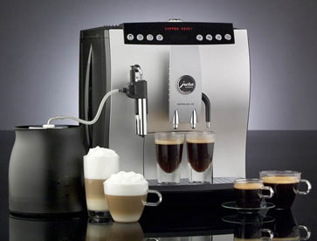
Questions???

